Slide 1
Introduction to R
Santiago Caño Muñiz, Dr Aaron Weimann, Dr Chris Ruis
https://aweimann.github.io/floto-lab-learning-bioinformatics/docs/

Slide 2
The goal
2
Learning to program is learning to think
Learning R in a workshop is an impossible task. Hence, our goal is to illustrate the capabilities of this tool. How programming can make your work much easier.

Slide 3
Why learn R?
3
A way to represent ideas
Age | Sex | District | Shamba | Trypanosoma | Filaria
25 | M | Sese Island | Sewana | + | +
20 | M | Sese Island | Kaganda I | - | +
25 | M | Sese Island | Semagala I | + | +
30 | M | Sese Island | Kaganda I | - | +
20 | M | Sese Island | Semagala I | - | +
25 | M | Sese Island | Buvovu I | - | +
25 | M | Sese Island | Kaganda I | - | +
20 | M | Sese Island | Semagala I | - | +
30 | M | Sese Island | Buvu I | - | +
35 | M | Sese Island | Semagala I | - | -
20 | M | Sese Island | Semagala I | - | -
…… | …… | …… | …… | …… | ……
…… | …… | …… | …… | …… | ……
…… | …… | …… | …… | …… | ……
25 | M | Sese Island | Semagala I | + | -
35 | M | Sese Island | Bunami I | + | +
Notes:
Statistics seems something we have to do in order to organise our inferences about the world.
So let´s say we have a list of cars, so we know their efficiency and power.
The list as such doesn’t tell us much.
We could, however, arrange the data in such a way that we could observe new relations.
This allow us to model the data in such a way that if we had a question about a car we have never seem, we could answer with quite good accuracy.

Slide 4
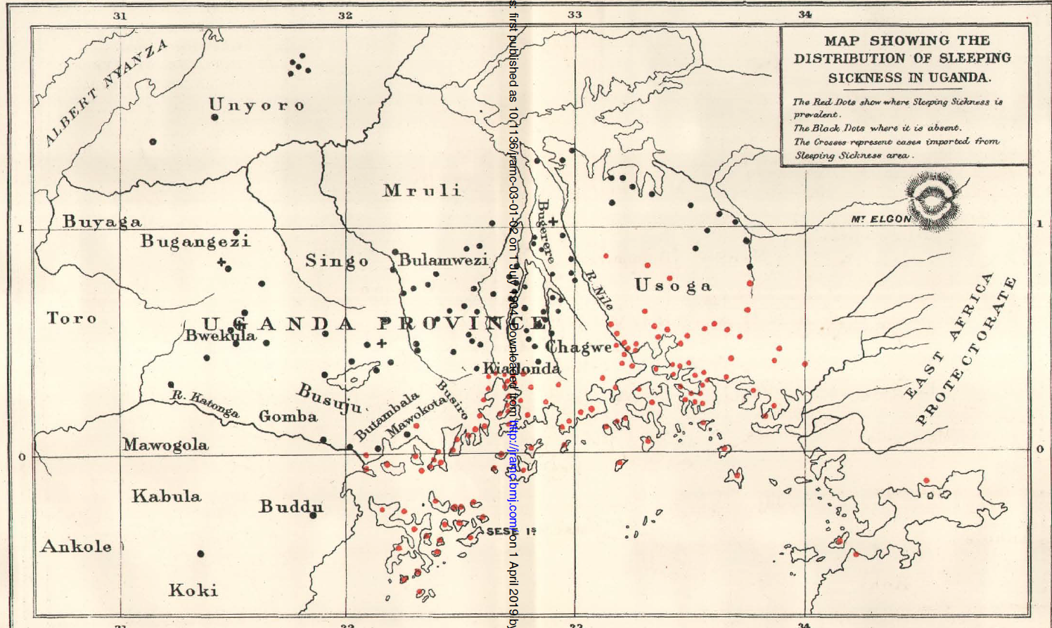
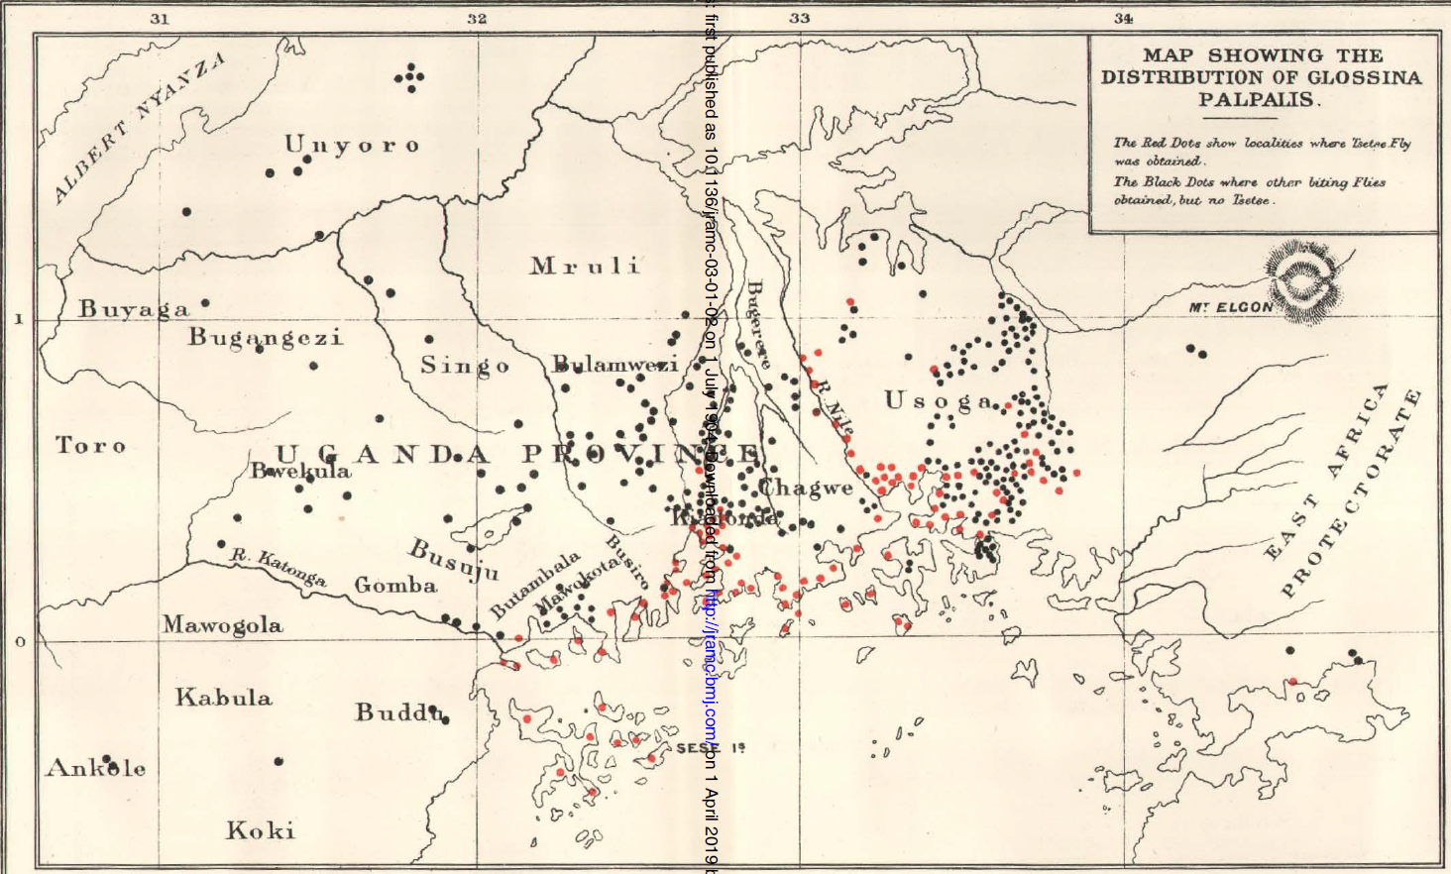
Why learn R?
4
A way to represent ideas
Age | Sex | District | Shamba | Trypanosoma | Filaria
25 | M | Sese Island | Sewana | + | +
20 | M | Sese Island | Kaganda I | - | +
25 | M | Sese Island | Semagala I | + | +
30 | M | Sese Island | Kaganda I | - | +
20 | M | Sese Island | Semagala I | - | +
25 | M | Sese Island | Buvovu I | - | +
25 | M | Sese Island | Kaganda I | - | +
20 | M | Sese Island | Semagala I | - | +
30 | M | Sese Island | Buvu I | - | +
35 | M | Sese Island | Semagala I | - | -
20 | M | Sese Island | Semagala I | - | -
…… | …… | …… | …… | …… | ……
…… | …… | …… | …… | …… | ……
…… | …… | …… | …… | …… | ……
25 | M | Sese Island | Semagala I | + | -
35 | M | Sese Island | Bunami I | + | +
Dr D. Bruce, 1903
Notes:
Statistics seems something we have to do in order to organise our inferences about the world.
So let´s say we have a list of cars, so we know their efficiency and power.
The list as such doesn’t tell us much.
We could, however, arrange the data in such a way that we could observe new relations.
This allow us to model the data in such a way that if we had a question about a car we have never seem, we could answer with quite good accuracy.

Slide 5
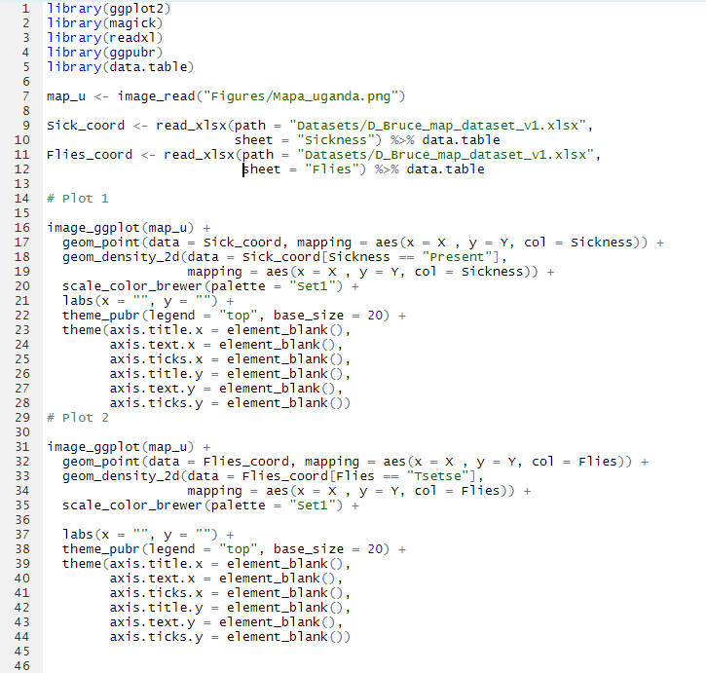

Why learn R?
5
A way to represent ideas
Age | Sex | District | Shamba | Trypanosoma | Filaria
25 | M | Sese Island | Sewana | + | +
20 | M | Sese Island | Kaganda I | - | +
25 | M | Sese Island | Semagala I | + | +
30 | M | Sese Island | Kaganda I | - | +
20 | M | Sese Island | Semagala I | - | +
25 | M | Sese Island | Buvovu I | - | +
25 | M | Sese Island | Kaganda I | - | +
20 | M | Sese Island | Semagala I | - | +
30 | M | Sese Island | Buvu I | - | +
35 | M | Sese Island | Semagala I | - | -
20 | M | Sese Island | Semagala I | - | -
…… | …… | …… | …… | …… | ……
…… | …… | …… | …… | …… | ……
…… | …… | …… | …… | …… | ……
25 | M | Sese Island | Semagala I | + | -
35 | M | Sese Island | Bunami I | + | +
Notes:
Statistics seems something we have to do in order to organise our inferences about the world.
So let´s say we have a list of cars, so we know their efficiency and power.
The list as such doesn’t tell us much.
We could, however, arrange the data in such a way that we could observe new relations.
This allow us to model the data in such a way that if we had a question about a car we have never seem, we could answer with quite good accuracy.

Slide 6
The cycle of data analysis
6
One ring to model them all
Information
Explore
Abstraction
Validation

Slide 7

What’s R
7
A tool to make life easier
Dynamic programming
Open source
Active community
Endless packages
Notes:
Orientado a estadística Dentro del campo del análisis de datos, R te permite realizar cualquier tipo de abstración que te imagines
Comunidad muy activa La facilidad de uso permite a los usuarios subir “paquetes” con nuevas funciones. Esto nos permite empezar nuestro trabajo donde otros terminaro.
Desventajas R en si no es un lenguaje de programación, sino un entorno. Como consecuencia, esto ha hecho que a nivel de rendimiento y flexibilidad R no esté a la altura de otros lenguajes como python

Slide 8
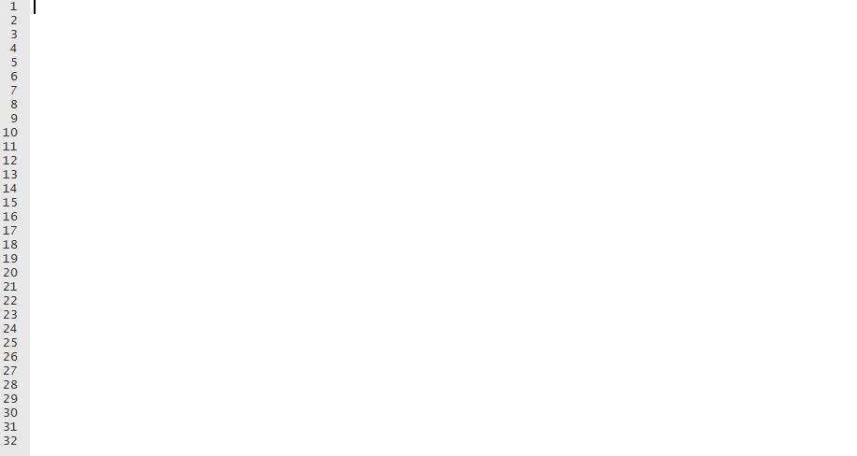
What’s R?
8
How was my first experience
Notes:
R is a language and environment for statistical computing and graphics. It is a GNU project which is similar to the S language and environment which was developed at Bell Laboratories (formerly AT&T, now Lucent Technologies) by John Chambers and colleagues. R can be considered as a different implementation of S. There are some important differences, but much code written for S runs unaltered under R.
R provides a wide variety of statistical (linear and nonlinear modelling, classical statistical tests, time-series analysis, classification, clustering, …) and graphical techniques, and is highly extensible.
Many users think of R as a statistics system. We prefer to think of it of an environment within which statistical techniques are implemented. R can be extended (easily) via packages.
The best thing about R it is that it was developed by statisticians. The worst thing about R is that… it was developed by statisticians. Bo Cowgill.

Slide 9
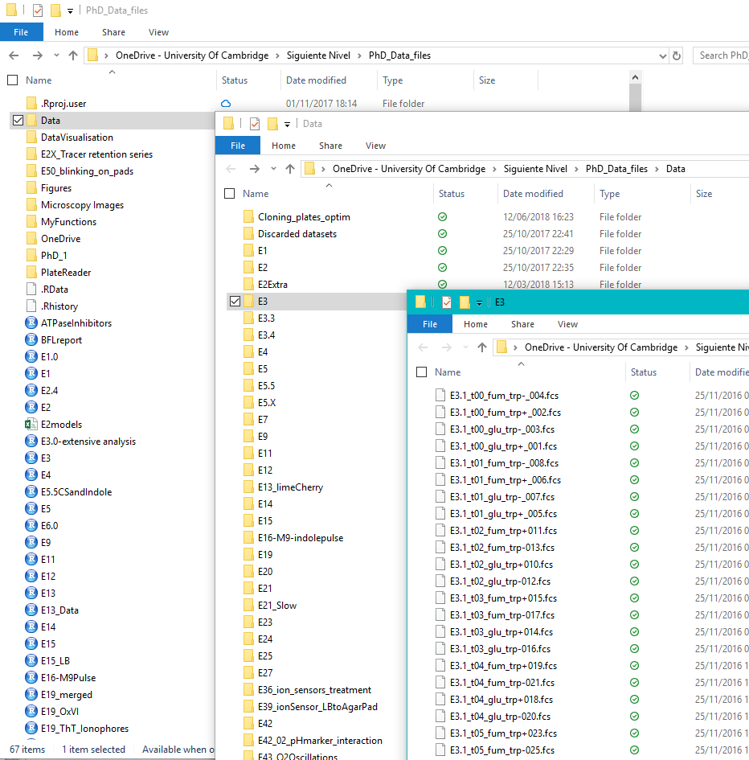
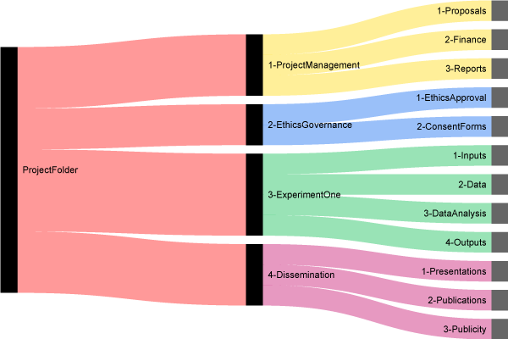
Arrange files and folders
9
Thinking in hierarchical order
® http://nikola.me/folder_structure.html
Notes:
Even if you work alone, it is useful, and it can also be used for text files, e.g. if you use markdown/knitr/Sweave combos (see Reproducible Research). I use Git with Dropbox to track my progress both for code and reports.
Each project has its own working directory. You can achieve that in bare R, but R studio manages this automatically.
The same goes for your workspace, each project has a separate one.
Source files you had open in re-loaded project will open automatically.
La organización de archivos de forma sistemática permite trabajar de forma dinámica con la información
Carpetas y

Slide 10
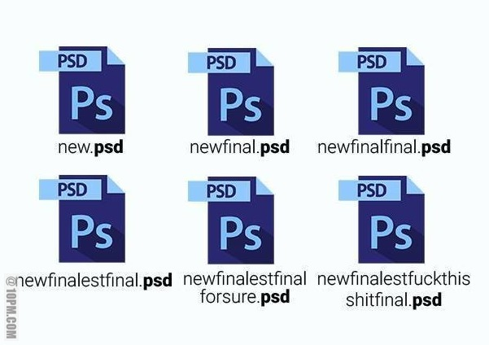
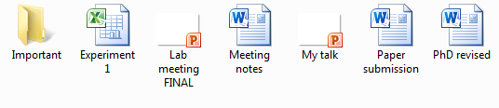
Arrange files and folders
10
Naming… really matters?
Copyright: http://10pm.com/
What I do
EXP_AAAAMMDD_NOMBRE_VX.X.csv
Will we remember what does it means at the end of the thesis or Project?
Avoid: ?, $,%, ^, &, *, (, ),-,#, ?,,,<,>, /, |, \, [ ,] ,{, and };
Notes:
Even if you work alone, it is useful, and it can also be used for text files, e.g. if you use markdown/knitr/Sweave combos (see Reproducible Research). I use Git with Dropbox to track my progress both for code and reports.
Each project has its own working directory. You can achieve that in bare R, but R studio manages this automatically.
The same goes for your workspace, each project has a separate one.
Source files you had open in re-loaded project will open automatically.
La organización de archivos de forma sistemática permite trabajar de forma dinámica con la información
Carpetas y

Slide 11
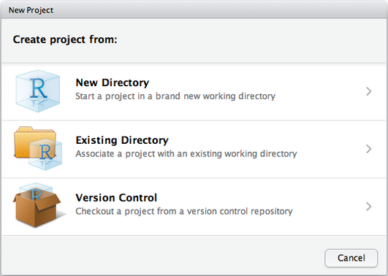
RStudio
11
A helper in our quest
Notes:
Even if you work alone, it is useful, and it can also be used for text files, e.g. if you use markdown/knitr/Sweave combos (see Reproducible Research). I use Git with Dropbox to track my progress both for code and reports.
Each project has its own working directory. You can achieve that in bare R, but R studio manages this automatically.
The same goes for your workspace, each project has a separate one.
Source files you had open in re-loaded project will open automatically.
La organización de archivos de forma sistemática permite trabajar de forma dinámica con la información
Carpetas y

Slide 12
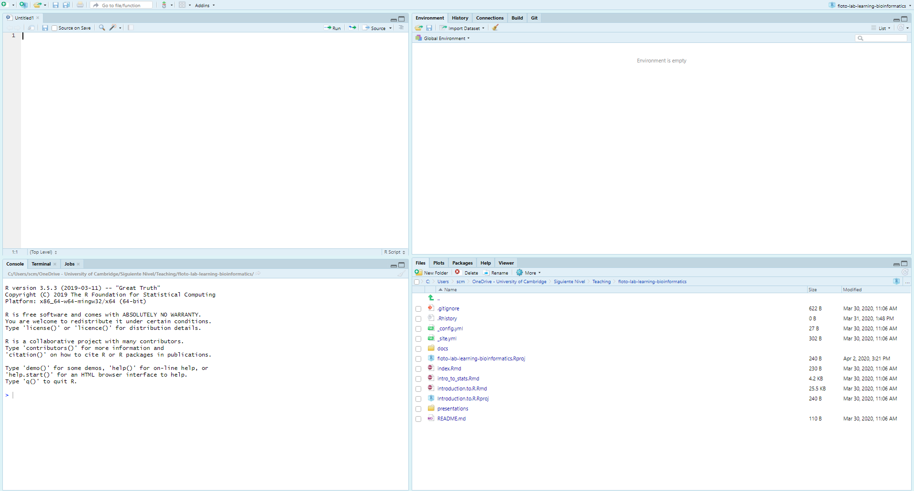
Inside R
12
RStudio
Editor
Objects and variables
Terminal
Plots, files, packages….

Slide 13
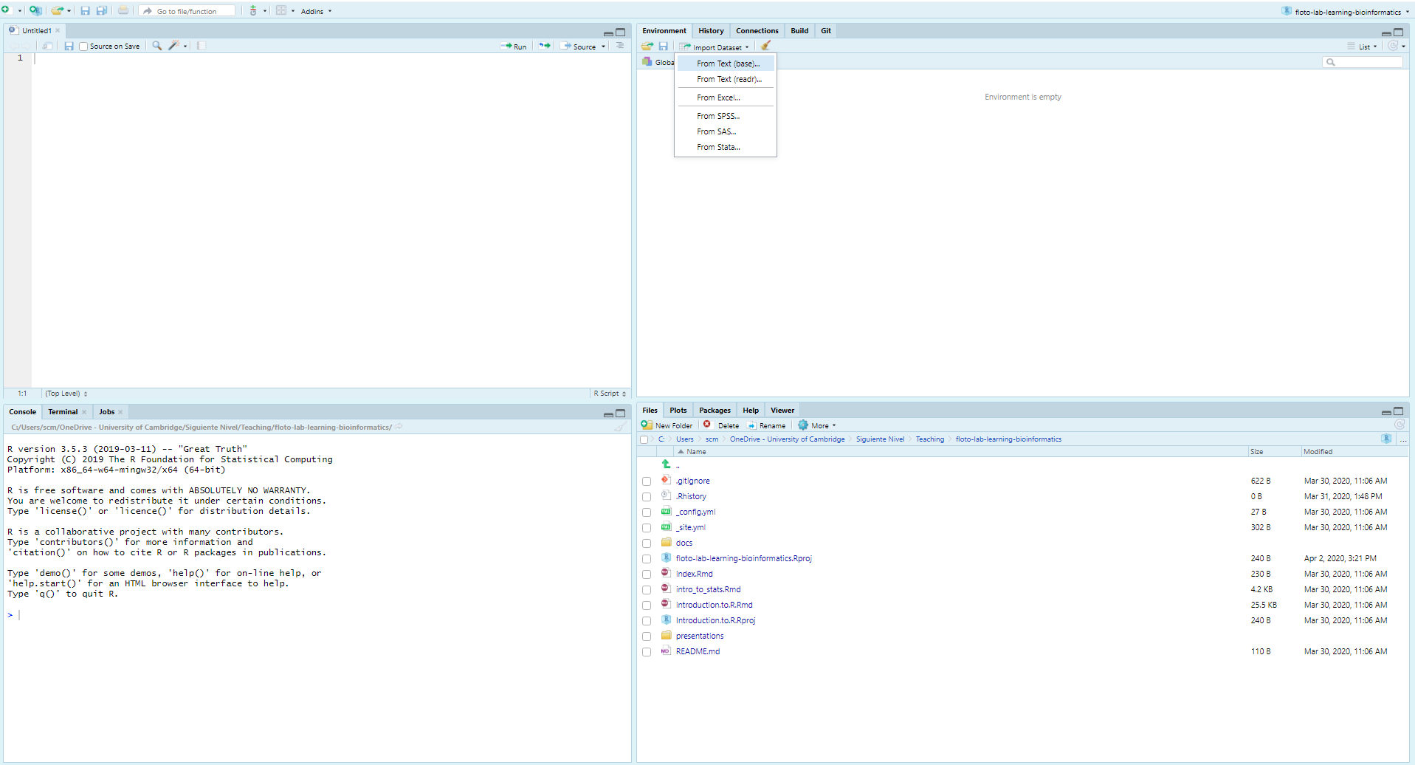
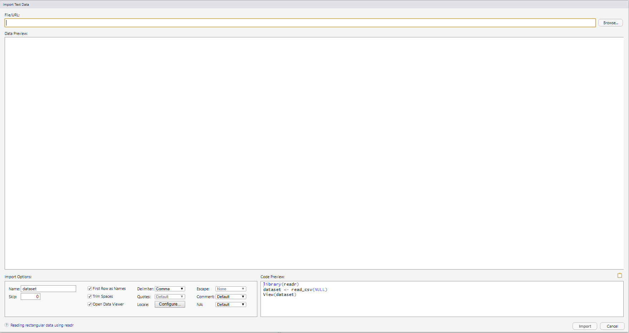
Inside R
13
Importing data

Slide 14
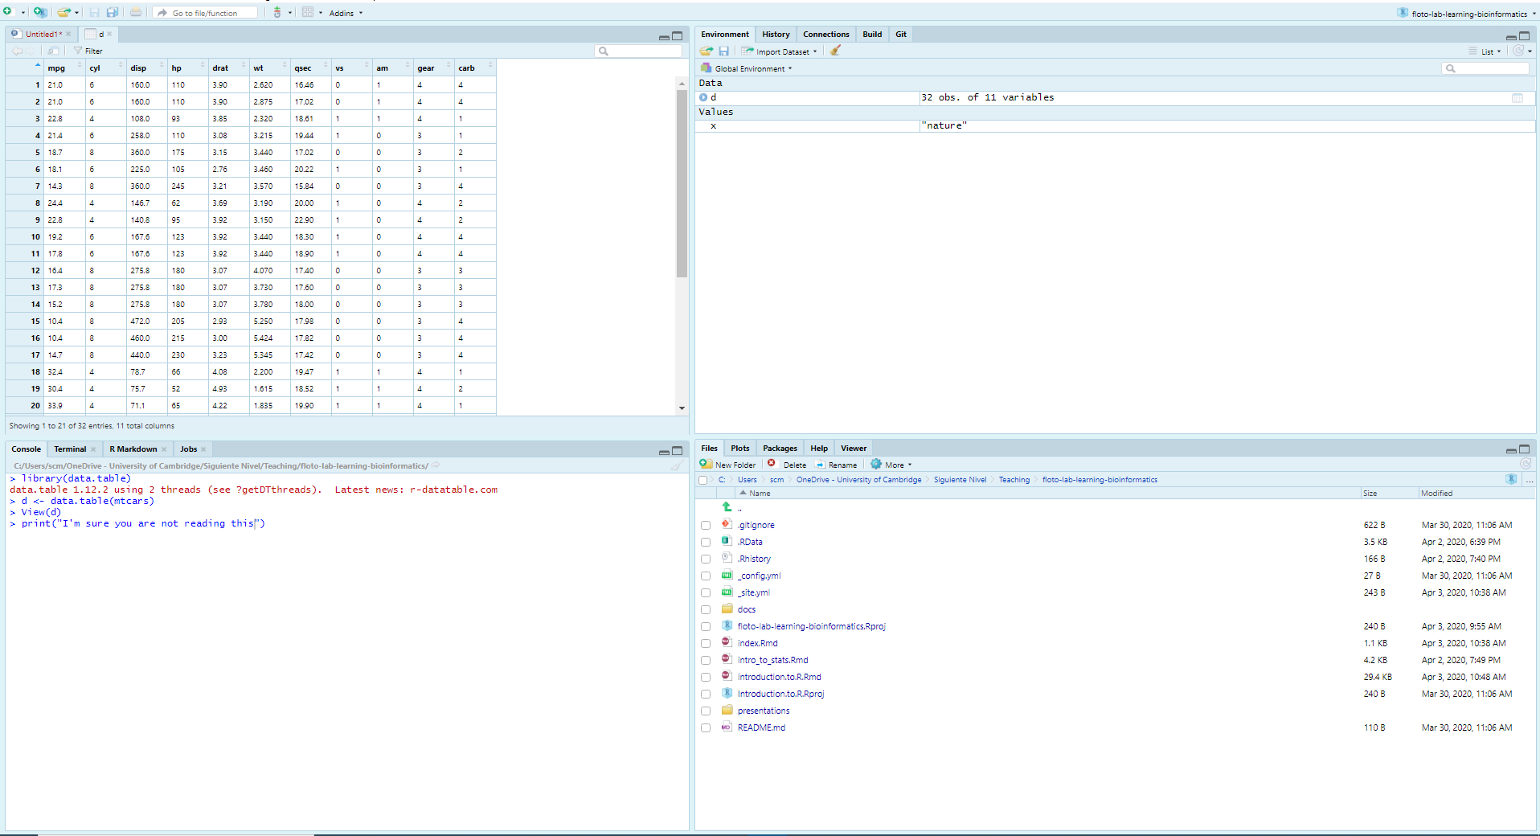
Inside R
14
Exploring datasets

Slide 15
Time to program
For example

Slide 16
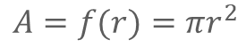
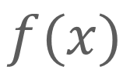
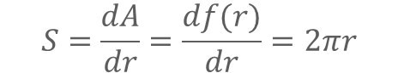
The foundation of R
16
The heir of mathematical notation
$$f(x)$$
Input
Output
$$A=f(r)=πr^{2}$$
$$S=\frac{dA}{dr}=\frac{df(r)}{dr}=2πr$$
Notes:
Una función “f de r” nos permite transformar de radio a área
Una función puede ser otra función
El input esperado de una función siempre ha de ser el mismo

Slide 17
The foundation of R
17
Functional programming
Function
Body
Environment
Args.
Input
Output
Notes:
For now, just remember that you do things in R by creating and manipulating named objects. You manipulate objects by feeding information about them to functions. The functions do something useful with that information (calculate a mean, recode a variable, fit a model) and give you the results back.

Slide 18
R like a super-calc on steroids
18
But… what’s a function?
specify “x” and “y”
The 3 elements
Action <- function(x, y = 0) {
z <- x + y
return(z)
}
Args: List of items, specified by order or name.
Body: Transformations upon the arguments.
Env: Variables accessible within the body.
Default “y” when we don’t specify it
Add “x” e “y”
Return the result

Slide 19
R like a super-calc on steroids
19
But… what’s a function?
# Intro to functions
runif(n = 10, min = 3, max = 10) # This function generates 10 random numb between 3 and 10
runif(10, 3, 10) # Same but using argument position as reference
runif(n = 10) # Get 10 random numbers within the default range
runif(10) # 10 random numbers within the default range setting n by position
runif(min = -1, n = 3) # Using the name allows the order to be alter
# Basic math functions
1 + 8
2 - 9
2 * 3
5/3

Slide 20
R like a super-calc on steroids
20
Logic operations
x == y # Is x equal to y
identical(x, y) # Same as == but using a function
!x # Negate (or logic inversión) of x
x & y # Is x AND y True?
x | y # Is x OR y True?
x < y # Is X Lower than y
x > y # Is X Bigger than y
x <= y # Is X Lower or equal than y
x >= y # Is X Bigger or equal than y
x != y # Is x different from y
xor() # Is only X or Y True?
isTrue() # Is true?

Slide 21
R like a super-calc on steroids
21
In R you have a function for everything
A <- ... # Assigning a variable
c(object, object,...) # Concatenate SAME type objects within a vector
length(object) # Number of elements in an object
str(object) # Show the internal structure of an object
class(object) # Show the class of an object
names(object) # Names of the elements
rm(object) # Remove the object
mean(vector) # Media
median(vector) # Median
sd(vector) # Standard deviation
sqrt(vector) # Square root
log(vector) # Natural logarithm
exp(vector) # E to the power of..
summary() # Summary
getwd() # Where we are working
read.delim() # Imporf files (also read.csv, read.csv2, read.txt, read.table)

Slide 22
Time to program
For example
mean(1:5, 0.1)
mean(x = 1:5, trim = 0.1)
mean(1:5, trim = 0.1)
mean(x = 1:5, 0.1)

Slide 23
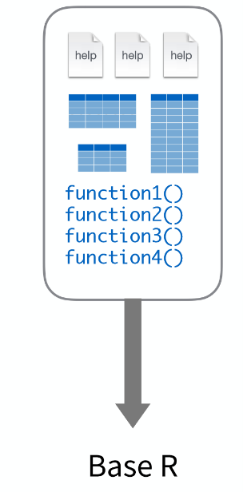
The R packages
23
Families of functions comes in packages
What they are
The R community that develops related functions adds them in a library that other users can download and install. This allows us to start our work where others finished and focus our efforts on a single problem. They are usually accompanied by instruction books called " vignette " that explain how to use the functions of the library.
install.package(data.table) # Install library from CRAN devtools::install_github("/paul-buerkner/brms") # Install from GitHub
library(tidyverse) # Load library
data.table::melt.data.table() # Calling a function from a # library
[image taken from Ryan Wesslen presentation]
Notes:
La comunidad de R que desarrolla funciones relacionadas las agrega en una librería que otros usuarios puede descargar e instalar
Esto nos permite empezar nuestro trabajo donde otros terminaron y concentrar nuestro esfuerzo en una solo problema
Suelen venir acompañados de libros de instrucciones llamados “vignette” que nos explican como usar las funciones de la librería

Slide 24

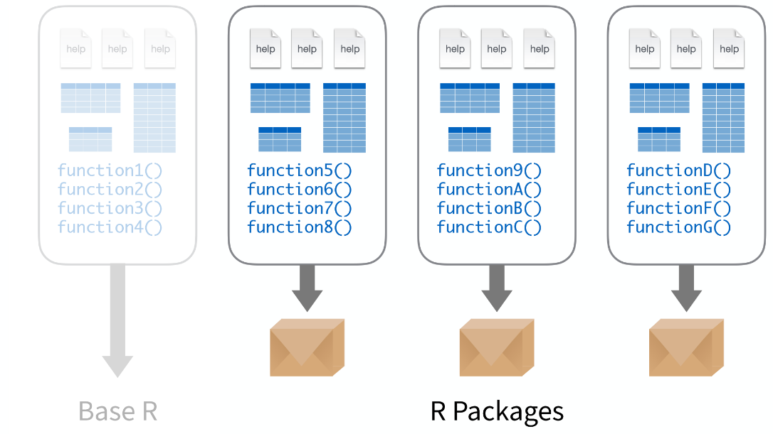



The R packages
24
Families of functions comes in packages
In this workshop we will work with the following bookstores: data.table, magrittr, ggplot, glmmTMB, mgcv
Beware of using too many libraries: Overlapping functions with the same name Reproducibility on other computers
[image taken from Ryan Wesslen presentation]
Notes:
En este taller trabajaremos con los siguientes librerías: data.table, magrittr, ggplot, glmmTMB, mgcv

Slide 25
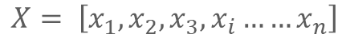
First contact
25
Representing mathematical objects
Vectors
$$X= \left[x_{1},x_{2},x_{3},x_{i}……x_{n}\right]$$
1 + 1 # Hashtag to write down comments
Nombre_x <- valor # Define objects with the operator <-
y <- 1
Numeric : $ℝ$
Numeric : ℝ
Logic: 1|0
0, -8, 3.14…
TRUE, FALSE, T, F
Character
“Que”, “es”, “eso”, “Eso es Queso”
Principios para nombrar una variable
Empezar por una letra, sin carateres irregulars (&, %, ^, …)
Breve y descriptivo. Para nombres compuestos conectar con _
`<-`(x, 2) # Assign
x <- y <- 1 # Assign multiple elements
y <- c(1, -2, 8, 5, 5e5) # Manually define a vector
z <- c("A", "B", "C") # Character vectors
x <- c(FALSE, TRUE, F, T) # Logic
x <- c(1L, 2L, 43L) # Integer
Notes:
Even if you work alone, it is useful, and it can also be used for text files, e.g. if you use markdown/knitr/Sweave combos (see Reproducible Research). I use Git with Dropbox to track my progress both for code and reports.
Each project has its own working directory. You can achieve that in bare R, but R studio manages this automatically.
The same goes for your workspace, each project has a separate one.
Source files you had open in re-loaded project will open automatically.
La organización de archivos de forma sistemática permite trabajar de forma dinámica con la información
Carpetas y

Slide 26
First contact
26
Representing mathematical objects
Vectors
x + y
x * 3
x / y
x^3
1:5 # Dos puntos ":" para indicar secuencias
5:1
y <- c(1, -2, 8, 5, 5e5)
y[3] # Extraer elementos
[1] 8
y[-2] # Numeros negativos para excluir elementos
[1] 1 8 5 5e5
y[2:3] # Extraer secuencia de elementos
# Nombrar elementos para crear diccionarios
y <- c("a" = 1, "b" = -2, "c" = 8, "d" = 5, "e" = 5e5)
y[“d"]
[1] 5
y[y > 5] # Extraer elementos usando test lógicos ( también ==, >=, <= )
c e
8e+00 5e+05
Notes:
Even if you work alone, it is useful, and it can also be used for text files, e.g. if you use markdown/knitr/Sweave combos (see Reproducible Research). I use Git with Dropbox to track my progress both for code and reports.
Each project has its own working directory. You can achieve that in bare R, but R studio manages this automatically.
The same goes for your workspace, each project has a separate one.
Source files you had open in re-loaded project will open automatically.
La organización de archivos de forma sistemática permite trabajar de forma dinámica con la información
Carpetas y

Slide 27
First contact
27
Representing mathematical objects
Recycling
# If two vectors have different length, the shorter one is recycled it will recycle to equal the length of the longest with the longest vector.
x = c(10, 20, 30)
y = c(1, 2, 3, 4, 5, 6, 7, 8, 9)
> y + x
# R uses "y" as a 9-element vector and "x" will repeat it 3 times
[1] 11 22 33 14 25 36 17 28 39
Notes:
If two vectors are of unequal length, the shorter one will be recycled in order to match the longer vector. For example, the following vectors u and v have different lengths, and their sum is computed by recycling values of the shorter vector u.

Slide 28
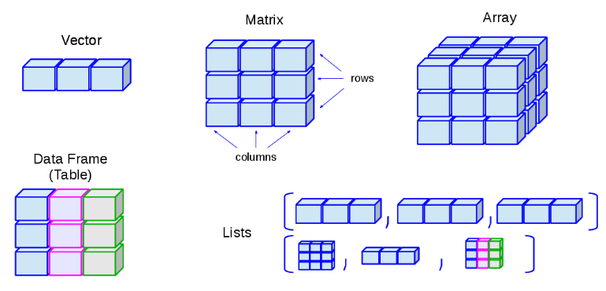

First contact
28
Representing mathematical objects
Homogeneous structures
mat <- matrix(c(1, -2, 8, 5, 7, 0, 3, 6, 9),
nrow = 3, ncol = 3)
mat[4] # Use array as vector
[1] 5
mat[1, 2] # mat[fila, columna]
[1] 5
mat[ ,c(1, 3)]
[,1] [,2]
[1,] 1 3
[2,] -2 6
[3,] 8 9
A <- array(data = 1:27, dim = c(3, 3, 3))
A[ 2, 2, 3]
[1] 23
[source: University of Cantabria]
Principles for naming a variable Within R, a matrix is a vector with two extra attributes:
Rows
Columns
Notes:
Even if you work alone, it is useful, and it can also be used for text files, e.g. if you use markdown/knitr/Sweave combos (see Reproducible Research). I use Git with Dropbox to track my progress both for code and reports.
Each project has its own working directory. You can achieve that in bare R, but R studio manages this automatically.
The same goes for your workspace, each project has a separate one.
Source files you had open in re-loaded project will open automatically.
La organización de archivos de forma sistemática permite trabajar de forma dinámica con la información
Carpetas y

Slide 29
First contact
29
Representing mathematical objects
Heterogeneous structures
mat <- matrix(c(1, -2, 8, 5), nrow = 2, ncol = 2)
mat[1, 2] # mat[fila, columna]
[1] 8
Animals <- list("a" = c(1, 4, 5, 2),
"b" = c("Cow", "Pig", “Chicken"))
Animals[["a"]][1] # [[ to access each item
Animals$a[1] # $ to access every element
[source: University of Cantabria]
Lists and tables
It contains structures of different types, or even contain a list They can also be of different length
Notes:
Even if you work alone, it is useful, and it can also be used for text files, e.g. if you use markdown/knitr/Sweave combos (see Reproducible Research). I use Git with Dropbox to track my progress both for code and reports.
Each project has its own working directory. You can achieve that in bare R, but R studio manages this automatically.
The same goes for your workspace, each project has a separate one.
Source files you had open in re-loaded project will open automatically.
La organización de archivos de forma sistemática permite trabajar de forma dinámica con la información
Carpetas y

Slide 30
Time to program
For example
x + y
x * 3
x / y
x^3
1:5 # Use colon ":" to indicate sequences
5:1
y <- c(1, -2, 8, 5, 5e5)
y[3] # Extract items
[1] 8
y[-2] # Negative numbers to delete elements
[1] 1 8 5 5e5
y[2:3] # Extract sequence of elements
# Name items to create “dictionaries”
y <- c("a" = 1, "b" = -2, "c" = 8, "d" = 5, "e" = 5e5)
y[“d"]
[1] 5
y[y > 5] # Extract elements using logical tests ( también ==, >=, <= )
c e
8e+00 5e+05

Slide 31
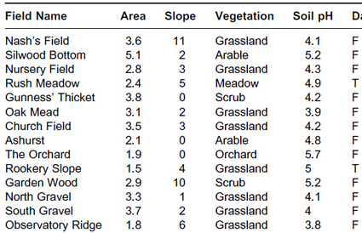
Tables
31
Data.fame
table <- data.frame(Field_N = c(“Nash`s", “Silwood", “Nursery",
“Rush", “Gunness", “Oak Mead", “Church Field"),
Area = c(3.6, 5.1, 2.8, 2.4, 3.8, 3.1, 3.5),
Slope = c(11, 2, 3, 5, 0, 2 , 3),
Vegetation = c(“Grass", “Arabl", “Grass",
“Meadow", “Scrub", “Grass", “Grass"))
# Create by adding pre-existing vectors
table <- data.frame(Field_N, Area, Slope, Vegetation)
# Join tables
table <- cbind(Field_N, Area, Slope, Vegetation)
table <- rbind(table_1, table_2)
# Also via read.*
table <- read.csv(«path/to/my/file")
Intuitively, data.frame is the classic way to represent information in our minds.
Like excel sheet Each column represents a vector
Each row a case
Notes:
A data frame is a set of rows and columns.
Each row is of the same length and data type
Every column is of the same length but can be of differing data types
A data frame has characteristics of both a matrix and a list
Bracket notation is the customary method of indexing into a data frame

Slide 32
Tables
32
Data.fame
Intuitively, data.frame is the classic way to represent information in our minds.
Like excel sheet Each column represents a vector
Each row a case
head(table) # Exploring head/tail values
tail(table)
str(table)
table$Area # Expose values
mean(table$Slope)
summary(table)
table[1, 2] # Access values as matrix
table[, 2:3]
table[, "nombre"] # Access values via naming
Notes:
A data frame is a set of rows and columns.
Each row is of the same length and data type
Every column is of the same length but can be of differing data types
A data frame has characteristics of both a matrix and a list
Bracket notation is the customary method of indexing into a data frame

Slide 33
Data.table
33
An expansion to data.frame
Properties
Syntax and usage is similar to data.frame
It's extremely fast It offers tools for: Data aggregate
Update cells Join tables
Allows elegant notation No dependencies
DT[ i, j, by]
Where
What
Which

Slide 34
Data.table
34
Continuation
matrix(data.table)
d <- data.table(mtcars, keep.rownames = TRUE)
> rn mpg cyl disp hp drat wt qsec vs am gear carb
1: Mazda RX4 21.0 6 160.0 110 3.90 2.620 16.46 0 1 4 4
2: Mazda RX4 Wag 21.0 6 160.0 110 3.90 2.875 17.02 0 1 4 4
3: Datsun 710 22.8 4 108.0 93 3.85 2.320 18.61 1 1 4 1
4: Hornet 4 Drive 21.4 6 258.0 110 3.08 3.215 19.44 1 0 3 1
5: Hornet Sportabout 18.7 8 360.0 175 3.15 3.440 17.02 0 0 3 2
6: Valiant 18.1 6 225.0 105 2.76 3.460 20.22 1 0 3 1
7: Duster 360 14.3 8 360.0 245 3.21 3.570 15.84 0 0 3 4
# How to perform simple extraction operations?
d[cyl > 4] # Filter with a simple logical test
d[rn %in% c("Mazda RX4", "Hornet Sportabout")] # Elementros within a vector
d[rn %like% "Mazda"] # Extract similar elements
Notes:
Even if you work alone, it is useful, and it can also be used for text files, e.g. if you use markdown/knitr/Sweave combos (see Reproducible Research). I use Git with Dropbox to track my progress both for code and reports.
Each project has its own working directory. You can achieve that in bare R, but R studio manages this automatically.
The same goes for your workspace, each project has a separate one.
Source files you had open in re-loaded project will open automatically.
La organización de archivos de forma sistemática permite trabajar de forma dinámica con la información
Carpetas y

Slide 35
Data.table
35
Continuation
# Summarise data
d[, .(g_mean = mean(cyl)), # By group
by = gear]
d[, .(g_mean2 = mean(cyl)),
by = .(gear, vs)] # Multiple groups
d[, Ref_col_mean := mean(hp), # Multiple-groups and create a new column
by = .(gear, vs)]
d[, .(“mean_hp", “mean_cyl"):= # Multiple-groups and multiple columns
.(mean(hp),
mean(cyl),
by = .(gear, vs)]
d[, mean(wt[vs == 0])/mean(wt[vs == 1])] # Vector within a column
Notes:
Even if you work alone, it is useful, and it can also be used for text files, e.g. if you use markdown/knitr/Sweave combos (see Reproducible Research). I use Git with Dropbox to track my progress both for code and reports.
Each project has its own working directory. You can achieve that in bare R, but R studio manages this automatically.
The same goes for your workspace, each project has a separate one.
Source files you had open in re-loaded project will open automatically.
La organización de archivos de forma sistemática permite trabajar de forma dinámica con la información
Carpetas y

Slide 36
Time to program
For example
# Summarise data
d <- data.table(mtcars)
d[, .(m = mean(cyl)), # By group
by = gear]
d[, .(m = mean(cyl)),
by = .(gear, vs)] # Multiple groups
d[, m_hp := mean(hp), # Multiple-groups and create a new column
by = .(gear, vs)]
d[, .(“m_hp", “m_cyl"):= # Multiple-groups and multiple columns
.(mean(hp),
mean(cyl),
by = .(gear, vs)]
d[, mean(wt[vs == 0])/mean(wt[vs == 1])] # Vector within a column

Slide 37
Pipes
37
Moving A %>% B
Placeholder
The %>% operator
One of the most useful and powerful elements of R. The operator ¨%>% helps structure the code and minimizes the creation of "transitional variables.
Requires package magrittr o tidyverse.
The basic idea:
x %>% f is f(x)
x %>% f %>% g %>% h is h(g(f(x)))
Object %>%
function1(.) %>%
function2(.) ->
result
Notes:
Even if you work alone, it is useful, and it can also be used for text files, e.g. if you use markdown/knitr/Sweave combos (see Reproducible Research). I use Git with Dropbox to track my progress both for code and reports.
Each project has its own working directory. You can achieve that in bare R, but R studio manages this automatically.
The same goes for your workspace, each project has a separate one.
Source files you had open in re-loaded project will open automatically.
La organización de archivos de forma sistemática permite trabajar de forma dinámica con la información
Carpetas y

Slide 38
Pipes
38
Moving A %>% B
Example: Representing averages by group
The %>% operator
One of the most useful and powerful elements of R. The operator ¨%>% helps structure the code and minimizes the creation of "transitional variables.
Requires package magrittr o tidyverse.
The basic idea:
x %>% f is f(x)
x %>% f %>% g %>% h is h(g(f(x)))
# Extract values Subset <- table[ table$a > "Value_x"]
# Sumity the information mus <- aggregate(test ~ condition, Subset, FUN = mean)
stds <- aggregate(test ~ condition, Subset, FUN = sd) summary_Ss <- merge(mus, stds, by = "condition")
# Create the graph colnames(summary_Ss)<- c("condition","mus","stds")
ggplot(summary_Ss, aes(x = condition, y = mus)) +
geom_point() +
geom_errorbar(aes(ymin = mus - stds,
ymax = mus + stds)) +
theme_bw()
Stack of lazy variables
Notes:
Even if you work alone, it is useful, and it can also be used for text files, e.g. if you use markdown/knitr/Sweave combos (see Reproducible Research). I use Git with Dropbox to track my progress both for code and reports.
Each project has its own working directory. You can achieve that in bare R, but R studio manages this automatically.
The same goes for your workspace, each project has a separate one.
Source files you had open in re-loaded project will open automatically.
La organización de archivos de forma sistemática permite trabajar de forma dinámica con la información
Carpetas y

Slide 39
Pipes
39
Moving A %>% B
Example: Representing averages by group
Code Unreadable
The %>% operator
One of the most useful and powerful elements of R. The operator ¨%>% helps structure the code and minimizes the creation of "transitional variables.
Requires package magrittr o tidyverse.
The basic idea:
x %>% f is f(x)
x %>% f %>% g %>% h is h(g(f(x)))
summary_Ss <- merge(aggregate(test ~ condition,
table[, table$a > "valor_x"], FUN = mean),
aggregate(test ~ condition,
table[, table$a > "valor_x"], FUN = sd), by = "condition")
# Create the graph
colnames(summary_Ss)<- c("condition","mus","stds")
ggplot(summary_Ss, aes(x = condition, y = mus)) +
geom_point() +
geom_errorbar(aes(ymin = mus - stds,
ymax = mus + stds)) +
theme_bw()
Notes:
Even if you work alone, it is useful, and it can also be used for text files, e.g. if you use markdown/knitr/Sweave combos (see Reproducible Research). I use Git with Dropbox to track my progress both for code and reports.
Each project has its own working directory. You can achieve that in bare R, but R studio manages this automatically.
The same goes for your workspace, each project has a separate one.
Source files you had open in re-loaded project will open automatically.
La organización de archivos de forma sistemática permite trabajar de forma dinámica con la información
Carpetas y

Slide 40
Pipes
40
Moving A %>% B
Example: Representing averages by group
The %>% operator
One of the most useful and powerful elements of R. The operator ¨%>% helps structure the code and minimizes the creation of "transitional variables.
Requires package magrittr o tidyverse.
The basic idea:
x %>% f is f(x)
x %>% f %>% g %>% h is h(g(f(x)))
table[a > “value_x" ] %>% # ﬁlter
.[, .(mus = mean(test),
stds = sd(test),
by = condition] %>% # Calculate parameters
# Graphical representation
ggplot(., aes(x = condition, y = mus) +
geom_point()
geom_errorbar(aes(ymin = mus - stds,
ymax = mus + stds) +
theme_bw()
Notes:
Even if you work alone, it is useful, and it can also be used for text files, e.g. if you use markdown/knitr/Sweave combos (see Reproducible Research). I use Git with Dropbox to track my progress both for code and reports.
Each project has its own working directory. You can achieve that in bare R, but R studio manages this automatically.
The same goes for your workspace, each project has a separate one.
Source files you had open in re-loaded project will open automatically.
La organización de archivos de forma sistemática permite trabajar de forma dinámica con la información
Carpetas y

Slide 41
Time to program
For example
library(tidyverse)
library(data.table)
data("mtcars") # Load data
d <- data.table(mtcars, keep.rownames = T)
d[, cyl > 3] %>%
ggplot(., aes(x = disp, y = wt)) +
geom_point() +
theme_bw
d %>%
lm(formula = disp ~ wt, data = .) %>%
summary

Slide 42
Loops and functionals
42
The essence of programming
each
What are they? Computers are especially useful when the task requires repetition
R provides us with three basic tools to repeat:
For
The of *apply family
In addition, it is possible to filter with logical tests:
if
ifelse
Set x
for(i in x) {
operation
}
Notes:
Las personas somos increíblemente buenas en
But that breaks our rule of thumb: never copy and paste more than twice. Instead, we could use a for loop:

Slide 43
Loops and functionals
43
An example
# Generate a sample dataset
set.seed(2018)
d <- data.frame(replicate(6, sample(c(1:10, -99), 100, rep = TRUE)))
names(d) <- letters[1:6]
head(d)
a b c d e f
1 4 7 -99 9 9 2
2 6 2 8 10 6 10
3 1 -99 9 3 4 1
4 3 7 7 7 -99 6
How do I calculate the mean of each column? mean(d$a)
mean(d$b)
mean(d$b)
mean(d$d)
mean(d$e)

Slide 44
Loops and functionals
44
An example
# Looping with for
for (i in 1:ncol(d)) { # Using ":" to generate sequence of 1 to the number of columns
x <- mean(d[, i])
print(x)
}
# If we want to save the result, first we create an empty vector (or other format)
medias <- rep(NA, ncol(d))
for (i in seq_along(medias)) {
x <- mean(d[, i]) # We iterate by column medias[i] <- x # Save the result in the vector "means", position "i"
}

Slide 45
Loops and functionals
45
The essence of R
What are they? Computers are especially useful when the task requires repetition
R provides us with three basic tools to repeat:
For
The of *apply family
In addition, it is possible to filter with logical tests:
if
ifelse
*apply(x, Fun = f(x) )
To x apply function f
Notes:
Las personas somos increíblemente buenas en
But that breaks our rule of thumb: never copy and paste more than twice. Instead, we could use a for loop:

Slide 46
Loops and functionals
46
An example
# Iteration-*apply
medias <- apply(X = d, MARGIN = 2, FUN = mean)
> medias
a b c d e f
-4.26 -4.75 -1.85 -5.92 -4.43 1.40
# If we also want to specify other arguments, we can indicate them at the end
apply(X = d, MARGIN = 2, FUN = quantile, probs = c(0.1, 0.5, 0.9))
> a b c d e f
10% 1 -9 1 -99 -9 1
50% 4 5 5 5 6 5
90% 9 9 9 9 10 10

Slide 47
Loops and functionals
47
Basic programming
What are they? Computers are especially useful when the task requires repetition
R provides us with three basic tools to repeat:
For
The of *apply family
In addition, it is possible to filter with logical tests:
if
ifelse
ifelse(test = ***,
yes = Accion_A,
no = Accion_B)
Notes:
Las personas somos increíblemente buenas en
But that breaks our rule of thumb: never copy and paste more than twice. Instead, we could use a for loop:

Slide 48
Loops and functionals
48
An example
# Basic if loop
if (paper_acepted == TRUE) { # Notice, it only accepts 1 element at a time
print( “We are the best!")
}
# Nested if loop
if (publisher == “science”) {
print (“We are the best”)
} else if ( publisher == “arXiV” ){ # else if allow us to make another question
print (“Andres will kill you” )
} else { # Only else resolve all the remaining cases
print (“If you look for me, I am in the crying room”)
}
# Iterate throught if-test throught a vector
all_papers <- c(“accepted”, “accepted”, “accepted”, “rejected”)
ifelse(all_papers == “accepted”,
print(“Fantastic, it’s a science?”),
print(“If you look for me, I am in the crying room”)
)

Slide 49
Loops and functionals
49
An example
Looping with *apply
d <- apply(d, 2, function(x) {ifelse(x == -99, NA, x)})
medias <- apply(X = d, MARGIN = 2, FUN = mean)
# Looping with *apply and the pipe operator
medias <- apply(d, 2, function(x) {tmp <- ifelse(x == -99, NA, x)}) %>%
apply(X = ., MARGIN = 2, FUN = mean, na.rm = TRUE)
medias
# looping with*apply
medias <- apply(d, 2, function(x) {tmp <- ifelse(x == -99, NA, x)
mean(tmp, na.rm = TRUE)})
> medias
X1 X2 X3 X4 X5 X6
5.585106 5.369565 5.263736 5.866667 5.423913 5.217391

Slide 50

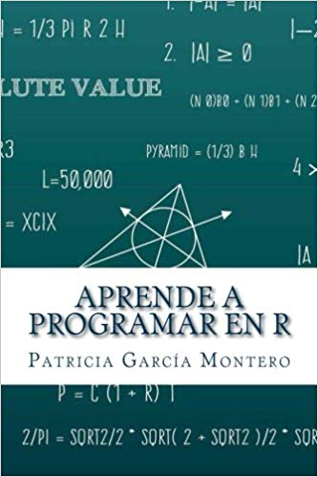
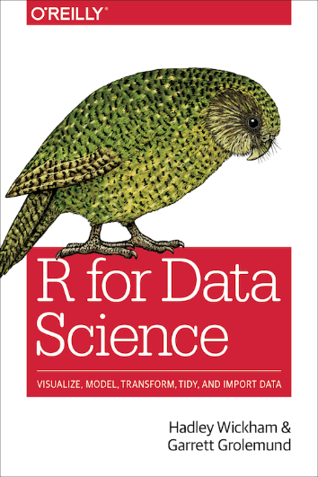
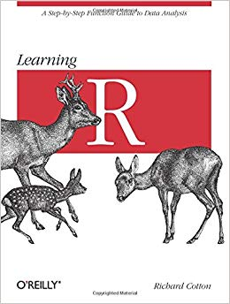
Support channels
50
Online resources
R for Data Science,
H. Wickham &
G. Grolemund
Learning R,
R. Cotton
R in a nutshell,
J. Adler
Aprender a programar en R
P. García Montero

Slide 51
¡Gracias por
vuestro tiempo!
¿Preguntas?

